Slide 1




Python Flask Tutorial
Prerequisites: Basic Python, SQL, html/html5, DB Handling, CSS/Bootstrap

Slide 2
Outline
What is Python Flask and Why use Python Flask?
What do you need?
Your first Flask-enabled page
Creating Database connection
Fetching data (Select Query)
Adding Data (Insert Query)
Updating Data (Update Query)
Delete Data (Delete Query)
Closing database connection
Tips and Hints

Slide 3
What is Python Flask and Why use Python Flask?
Flask is a web framework. This means flask provides you with tools, libraries and technologies that allow you to build a web application. This web application can be some web pages, a blog, a wiki or go as big as a web-based a commercial website.
Its written in Python. It is classified as a microframework because it does not require particular tools or libraries. It has no database abstraction layer, form validation etc.
Jinja2 is a full-featured template engine for Python. It has full unicode support, an optional integrated sandboxed execution environment, widely used.

Slide 4
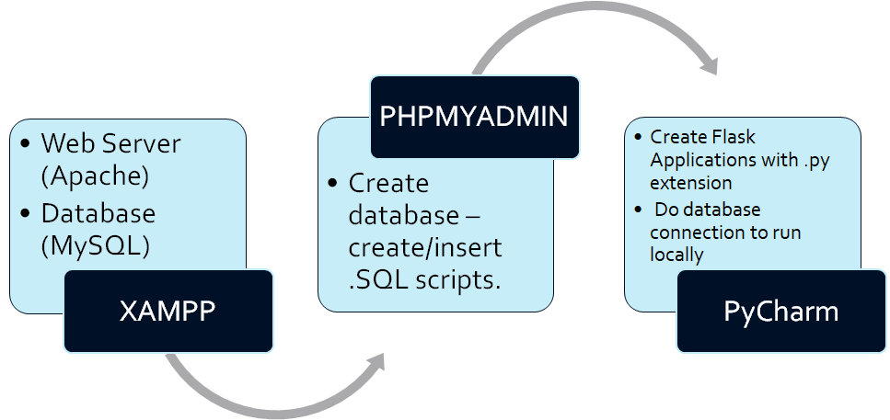
What do you need ?

Slide 5
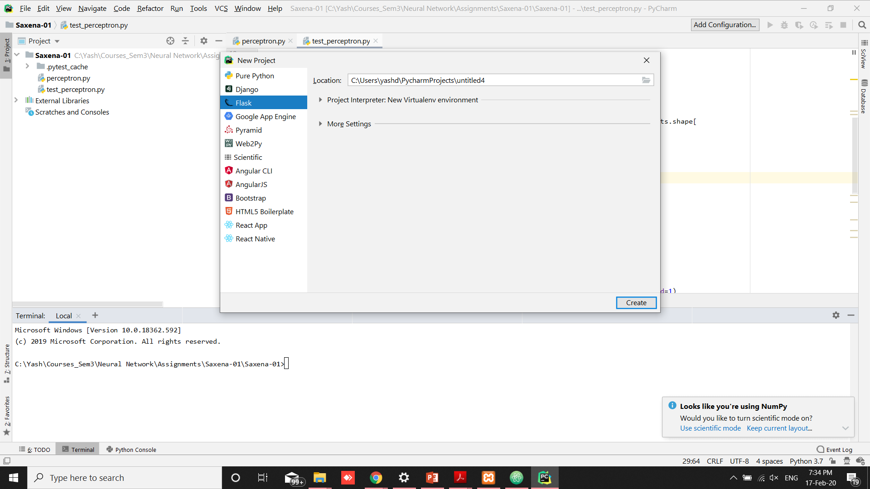
Install PyCharm and start new Flask Project

Slide 6
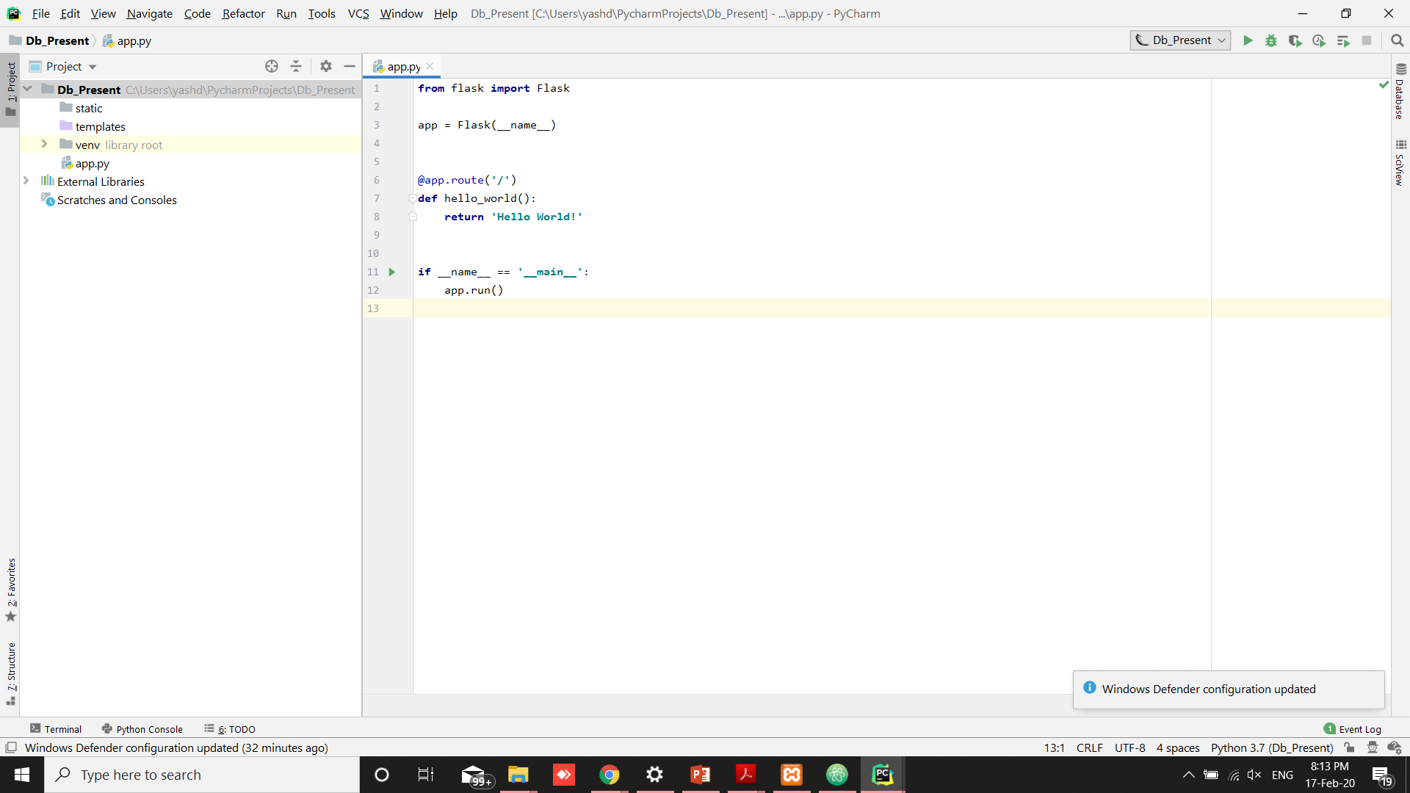
Python Flask project page with initial route

Slide 7
Database Connection
from flask_mysqldb import MySQL
app = Flask(__name__)
<name>.uta.cloud
app.config['MYSQL_HOST'] = 'localhost'
app.config['MYSQL_USER'] = 'root'
app.config['MYSQL_PASSWORD'] = 'test'
app.config['MYSQL_DB'] = '<DbName>'
mysql = MySQL(app)
Import MySQL plugin from Flask
Give HostName
Give UserName
Enter Password for DB
Enter Project Name
Making the connection

Slide 8
Fetching Data(Select Query)
@app.route('/fetchdata', methods=['GET', 'POST'])
def display():
if request.method == "POST":
details = request.form
studentid = details['stuid']
cur = mysql.connection.cursor()
cur.execute(“SELECT name, dept, gpa FROM students WHERE StudentId = '" + studentid + "'”)
result = cur.fetchall()
print(result)
mysql.connection.commit()
cur.close()
return render_template('xyz.html', result = result)

Slide 9
Adding Data(Insert Query)
@app.route('/insertvalue', methods=['GET', 'POST'])
def insert():
if request.method == "POST":
details = request.form
studentid = details['stuid']
name = details['name']
dept = details['dept']
gpa = details['gpa']
cur = mysql.connection.cursor()
cur.execute("INSERT INTO students(studentid, name, dept, gpa) VALUES (%s, %s, %s, %s)", (studentid, name, dept, gpa))
mysql.connection.commit()
cur.close()
return 'success'
return render_template('index.html')

Slide 10
Updating Data(Update Query)
@app.route('/updatedata', methods=['GET', 'POST'])
def update():
if request.method == "POST":
details = request.form
studentid = details['stuid']
cur = mysql.connection.cursor()
cur.execute("UPDATE students SET gpa = '3.85' WHERE studentId = '" + studentid + "'")
mysql.connection.commit()
cur.close()
return 'success'
return render_template('index.html')

Slide 11
Deleting Data(Delete Query)
@app.route('/deletedata', methods=['GET', 'POST'])
def delete():
if request.method == "POST":
details = request.form
studentid = details['stuid']
cur = mysql.connection.cursor()
cur.execute("DELETE FROM students WHERE StudentId = '" + studentid + "'")
mysql.connection.commit()
cur.close()
return 'success'
return render_template('index.html')

Slide 12
Form with route to take input and to take action
<!DOCTYPE html>
<HTML lang="en">
<BODY bgcolor="#add8e6">
<form method="POST" action="/deletedata">
<center>
<H1>Enter StudentId to delete: </H1> <br>
StudentId: <input type = "text" name= "stuid" /> <br>
<input type = "submit">
</center>
</form>
</BODY>
</HTML>

Slide 13
To Display passed data using Jinja
<!DOCTYPE html>
<html lang="en">
<head>
<meta charset="UTF-8">
<title>Query 3</title>
</head>
<body>
{{ result }}
</body> *Useful for Select Query
</html>
Jinja Implementation

Slide 14
There are multiple ways to use DB with flask, you can find those on internet.
If you are not able to understand this you can always try other methods.
Two or more tables can be joined in SQL queries and committing them into the connection.
Try to use pycharm ide, its professional version is free on your student Email id
Tips and Hints

Slide 15
Questions?

